Slide 1
SQL – BUILT IN FUNCTIONS

Slide 2
SCALAR FUNCTIONS
Oracle Scalar Functions allow you to perform different calculations on data values. These functions operate on single rows only and produce one result per row.
String functions – functions that perform operations on character values.
Numeric functions – functions that perform operations on numeric values.
Date functions – functions that perform operations on date values.
Conversion functions – functions that convert column data types.
NVL Function – function for handling null values.

Slide 3
STRING FUNCTIONS

Slide 4
STRING FUNCTIONS

Slide 5
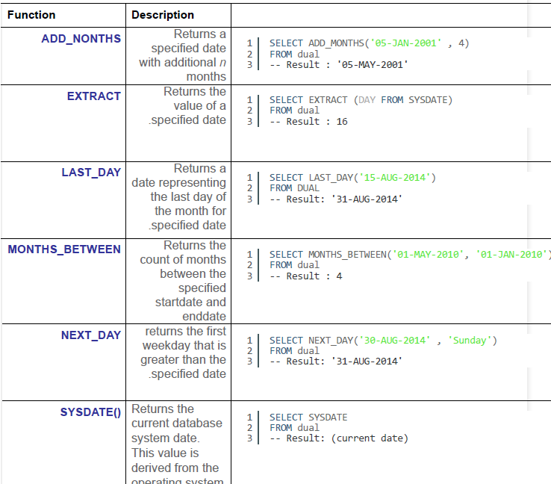
DATE FUNCTIONS

Slide 6
NUMERIC FUNCTIONS

Slide 7
CONVERSION FUNCTIONS

Slide 8
NVL Function

